Slide 1
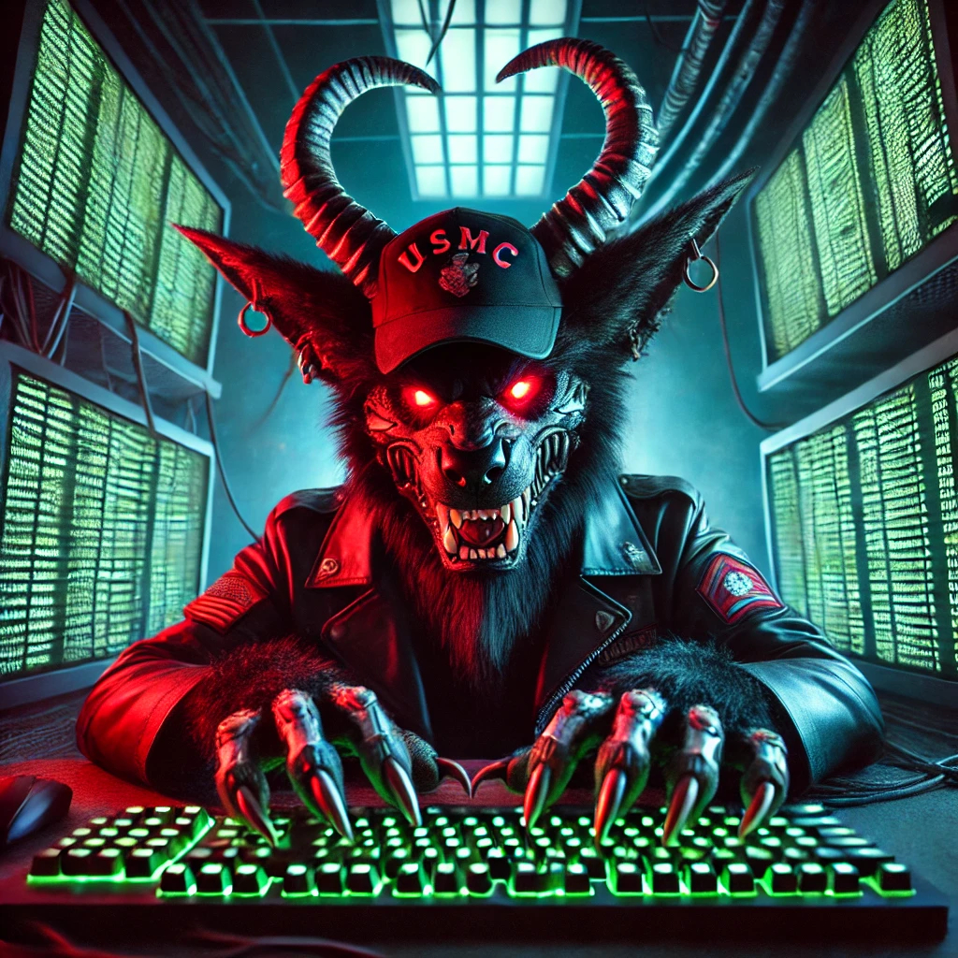
Embracing the “Generalist”
Dan Beaulieu, Information Security Engineer & Generalist
Notes:
Give credit to Wade for the wading through logs part.

Slide 2
Who Am I??
I’m a USMC Veteran, I worked on AV8 Harrier Jump Jets. (Very Cool stuff)
38 Years in IT with experience across multiple MSPs.
8-12 Years in Information Security
SME for email security, device and patch mgt, Risk Register & Vulnerability Management
Oh did I mention I have ADHD, If I go off on any tangents (Shiny Object>>>>>)

Slide 3
The Value of the InfoSec Generalist
As Information Security becomes increasingly complex, the ability to adapt, integrate, and navigate multiple domains is more important than ever. While deep expertise is critical in specialized roles, the generalist — someone who can operate across a wide array of functions — is becoming an indispensable asset.
This talk explores the evolving role of the Information Security generalist, emphasizing their ability to contribute to various areas of the field, drive cross-team collaboration, and provide strategic insight. With Information Security growing more interdisciplinary, generalists are proving to be the glue that holds complex systems and teams together.

Slide 4
Introduction
What is a generalist?
- Jack of All Trades Master of None? (Many!)
Why a Talk on being a Generalist?
Bridging gaps between very technical, very operational, and specific jobs/roles.
Notes:
Jack of all trades master of none! Asked to do many things in a day vs Just analyze,
Talk about applying for jobs but not having Enough Experience in 1 discipline which works against you in job apps….

Slide 5
Comparing Generalists and Specialists
Specialists: Deep expertise in niche areas.
Generalists: Breadth of knowledge across multiple domains.
How organizations benefit from combining specialists and generalists.
Is it the Ideal Balance?

Slide 6
Key Skills
Communication & Collaboration.
Breaking down silos between teams and departments.
Technical Competency.
Adaptability & Lifelong Learning.
Notes:
Don’t elaborate on Fire Dept or IVM here…

Slide 7
The Evolving Information Security Landscape
The convergence of Information Security with other fields (e.g., data science, compliance).
Why generalists are well-positioned to adapt to unknowns.
The Need for Generalists in Leadership.
Architectural know how
Notes:
Generalist's naturally lead to mgt positions. Also great at Security Architecture.

Slide 8
Real-World Challenges and Success Stories
Lessons from the Field:
Creation of the Internal Fire Dept
Creation of Risk Register between InfoSec and Infrastructure
Creation of Vulnerability Mgt by Regular Scanning
Notes:
Give examples of Fire Dept and Risk Register

Slide 9
Forever Learning
Since Finding InfoSec, I have found an insatiable need for learning.
I spend at least 10 hours a week learning.
I go to short conferences and Meetups in the “San Angeles” area.
I usually go to a week long conference somewhere in the US.
Notes:
Education is good but experience is better! Experience is better but Networking is best!

Slide 10
Places I Go (in San Diego Area)
San Diego Cyber Meetup
DefCon 858 / 619 (Rancho Bernardo)
Irvine Underground (IVU)
SD Cybersecurity Mixer
SD ISSA & SD AITP
SD OWASP
Null404 (Discord Group)
Notes:
SD ISSA: Info Systems Security Assoc, SD AITP: Association of Information Technology Professionals

Slide 11
Places I Have Gone
SANS Conferences, San Diego and Las Vegas
San Diego Bsides
Wild West Hacking Fest (Deadwood, SD)
Blackhat, Las Vegas

Slide 12
CPE’s, Continuing Professional education
If you have Certifications that need renewals, you need CPE’s.
Where do I get these CPE’s?
Any conference you attend, any training, and any informational webinar that records attendance.
Keep track of these and save to a folder any certs of completion/attendance you may receive.
Notes:
T-Minus is a great Space Industry one

Slide 13
Places I use…
ISC StormCast , Darknet Diaries, Cyberwire Daily from N2K, T-Minus(Great Podcast about Space Industry)
Talking Bout the News with Black Hills Info Sec
Antisyphon Training, Black Hills Info Sec
MetaCTF and Kringle Con
Simply Cyber, Gerald Auger
Finding InfoSec Events:
Wadingthrusecurity.com click SD Cyber Community
InfoSecMap.com by Martin Villalba built this online DB of events world wide, it’s very comprehensive!
Notes:
T-Minus is a great Space Industry one

Slide 14
Keeping Up with the Jones?
Avoiding burnout while balancing breadth with sufficient depth.
Driving Innovation and Integration.
Strategies for staying ahead in a rapidly evolving field.

Slide 15
Key Takeaways
Summary of Discussion Points:
The indispensable role of generalists in Information Security.
The balance between specialists and generalists in a robust team.
The importance of adaptability and integration.
Encouraging organizations and individuals to embrace the generalist mindset.

Slide 16
Q&A & Closing Remarks
Open the floor to audience questions.
Closing Remarks
Notes:
Invitation for Questions. Reiterate the value of the generalist in shaping the future of Information Security.

